Slide 1

Leading Talent
Case Study – EUC & Windows 10 End of Support Transformation
16/06/2026
© 2026 Leading Talent Ltd. All rights reserved.

Slide 2
Windows 10 end of support is not a refresh project.
It is a compliance
and cyber risk.
With Microsoft ending mainstream support for Windows 10 in October 2025, every unpatched endpoint becomes a liability. For regulated enterprises, this is a compliance event — not an upgrade cycle. Managed poorly, it triggers audit findings, cyber incidents, and operational disruption.
16/06/2026
© 2026 Leading Talent Ltd. All rights reserved.

Slide 3
Case Study: End of Support, Not End of Control — Enterprise Windows Transformation at Scale
Client Situation
A leading FTSE-listed enterprise with a 45,000-endpoint estate engaged Leading Talent following an internal audit that exposed significant compliance gaps — with fewer than 18 months to the October 2025 end-of-support deadline.
The data estate had grown organically: devices across dozens of business units and regions, a mix of managed and unmanaged endpoints, legacy hardware running non-standard images, and application compatibility gaps blocking Windows 11 readiness. Ingestion of device data into management tooling was inconsistent, lineage poor, and pipelines brittle.
With limited governance and stewardship, there was no consistent programme owner, no board-level risk visibility, and no systematic way to enforce quality and compliance standards across the estate. Downstream, these gaps created material business risk: audit exposure, Cyber Essentials non-compliance, and a growing backlog of unpatched vulnerabilities.
The Ask
Design and deliver a fully governed Windows 11 migration programme across a 45,000-endpoint estate — eliminating end-of-support risk, restoring Cyber Essentials Plus compliance, and maintaining BAU continuity throughout.
16/06/2026
© 2026 Leading Talent Ltd. All rights reserved.

Slide 4
Leading Talent provided end-to-end programme delivery across six structured phases
What did we do?
01
Discovery & Estate Audit A structured assessment of the full 45,000-endpoint estate: hardware scoring, OS/patch version breakdown, MDM coverage gaps, and compliance posture. Delivered within 3 weeks, creating a shared understanding of current state and prioritised remediation backlog.
02
Application Compatibility Review Automated compatibility scan plus manual Tier-1 application review. Remediation backlog of 847 applications scoped, vendor-triaged, and sequenced for minimal business disruption.
03
Image & Policy Design Windows 11 baseline build with Intune/Autopilot deployment configuration, BIOS standardisation, and CIS benchmark hardening — aligned to Cyber Essentials Plus requirements.
04
Phased Migration Waves Risk-stratified wave planning: pilot cohort → department waves → remote/VIP users. Full rollback capability maintained at every stage. 99.6% first-time success rate achieved.
05
Programme Governance Weekly SteerCo cadence, RAG dashboards, issue/risk log, and board-ready compliance reporting from week one — giving leadership full visibility throughout delivery.
06
Hypercare & Handover Four-week hypercare period post-wave completion. Full runbook and knowledge-transfer pack delivered to the in-house team, enabling sustainable ongoing management.
16/06/2026
© 2026 Leading Talent Ltd. All rights reserved.

Slide 5
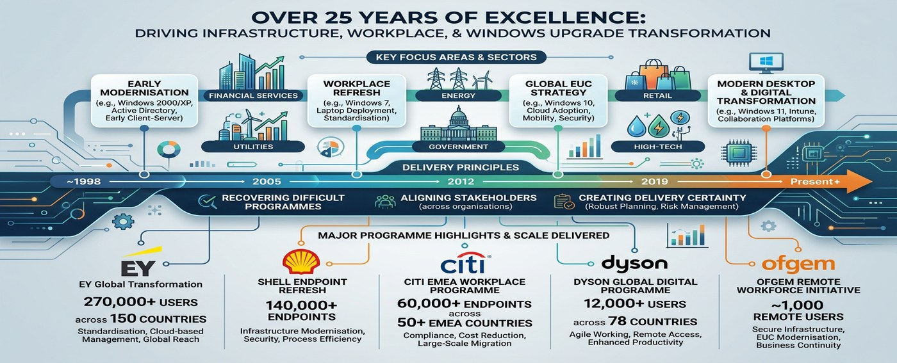
Visual Representation — 25+ Years of EUC Delivery Excellence
16/06/2026
© 2026 Leading Talent Ltd. All rights reserved.

Slide 6
Outcomes Delivered
45,000
100%
847
Endpoints Migrated
MDM Coverage
Apps Remediated
Full estate moved to Windows 11, 6 weeks ahead of the October 2025 deadline.
Intune-managed estate up from 61% to 100% — full device compliance achieved.
Full application compatibility resolved; 12 required bespoke remediation builds.
£2.1M
99.6%
CE+
Licence Cost Avoided
First-Time Success Rate
Compliance Retained
Extended support costs eliminated through on-time delivery and phased wave planning.
Migration waves achieved near-perfect delivery with zero unplanned service outages.
Cyber Essentials Plus certification maintained throughout migration without lapse.
16/06/2026
© 2026 Leading Talent Ltd. All rights reserved.

Slide 7
Why Leading Talent
Client Track Record
Programme-level EUC delivery
We operate at programme scale — not desktop engineering. Every engagement includes governance, risk management and board-level reporting.
EY
Global Workplace Transformation — cloud management, standardisation, global reach.
270,000 users · 150 countries
Proven at 10K–270K endpoint scale
Our credentials span EY (270,000 users, 150 countries), Shell (140,000+ endpoints), Citi (60,000 EMEA), Dyson (12,000 global), and Ofgem.
Shell
Endpoint Refresh Programme — infrastructure modernisation, security, process efficiency.
140,000+ endpoints · 78 countries
Deep Microsoft expertise
Citi
EMEA Workplace Programme — compliance, cost reduction, large-scale migration.
Intune, Autopilot, Azure Virtual Desktop, Entra ID, SCCM/ConfigMgr. We know the full modern device management stack.
60,000 endpoints · 50+ EMEA countries
Accredited & certified
Dyson
Global Digital Programme — agile working, remote access, enhanced productivity.
CCS G-Cloud framework accredited · Cyber Essentials certified supplier · ISO 27001 aligned delivery practices.
12,000 users · 78 countries
Ofgem
Remote Workforce Initiative — EUC modernisation, secure infrastructure, business continuity.
Embedded delivery model
We work alongside your team — not around it. Knowledge transfer is built into every phase, not bolted on at the end.
~1,000 remote users
16/06/2026
© 2026 Leading Talent Ltd. All rights reserved.

Slide 8
Ready to manage your Windows 10 risk?
hello@leadingtalent.co.uk · leadingtalent.co.uk
16/06/2026
© 2026 Leading Talent Ltd. All rights reserved.

